Slide 1

Airbnb Analysis in Austin

Slide 2


Background
Since 2008, Airbnb has been an online marketplace connecting people renting out their homes and people looking for accommodations in specific locations.
Currently, Airbnb has in excess of 6 million listings, spread over 100,000 cities and 220-plus countries.
In my analysis, I work on the listings data of Austin, Texas and extract insights and answer business problems.
Here is the Github link containing the SQL queries and the Tableau dashboard files.
https://github.com/vatsalmandalia/Airbnb-Listings-Analysis-SQL-Tableau.git

Slide 3

Preparing and Understanding the Data
Source of the data: Inside Airbnb for Austin, Texas.
There are three datasets – listings, reviews and calendar.
This data is scraped on 2022-06-08 as per the source.
Tools employed: SQL, DB Browser for SQLite, Tableau Public
In the listings data, the ‘price’ field has a non-numeric character ‘$’. This is corrected manually using the ‘Modify Table’ option in ‘Edit’ menu.
Listings
74 fields having information on listings, hosts, neighborhoods, price and availability
Calendar
7 fields on daily availability, price per night, minimum and maximum number of nights
6 fields with information on listing, date of review, name of reviewer and the comment
Reviews

Slide 4
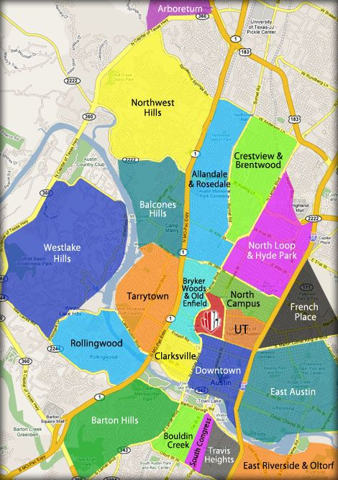
Business Problems
I will be answering the questions mentioned below.
How many listings and hosts are there in Austin? Are there hosts with multiple listings?
Across neighborhoods, what is the proportion of listings and the price situation?
What is the price per bed trend by each neighborhood?
What is the division of each type of room among all listings? How does the price correlate with a room type and neighbourhood?
In the next 30 days, what is the revenue potential across neighborhoods and room types?
What is the outlook of superhosts across each neighborhood – in terms of numbers, price and ratings?

Slide 5
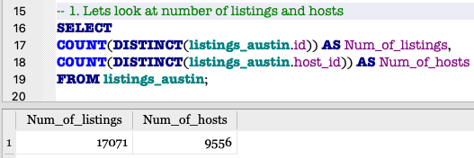
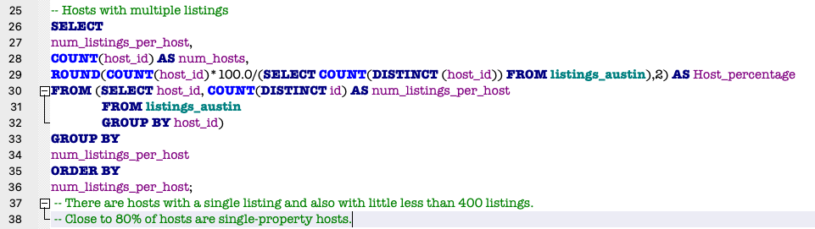
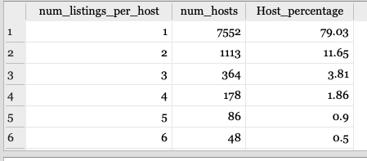
Hosts and Listings
Number of hosts and listings
Hosts with multiple listings
We have 17071 listings and 9556 hosts in Austin.
There are hosts with listings ranging from 1 to near 400 in number.
Close to 80% of hosts are single-property holders.
Those having 2 to 3 listings account for 16% among the 9556 hosts.

Slide 6
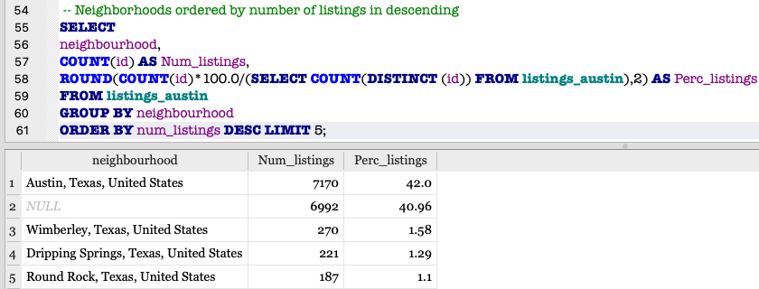
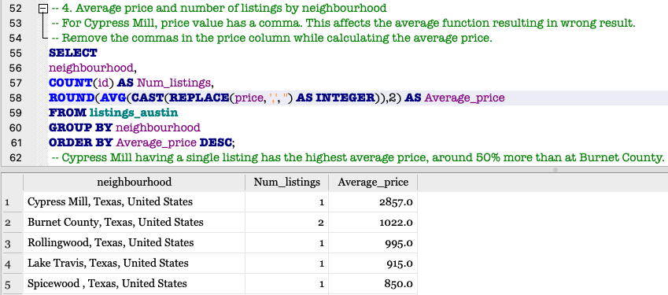
Neighborhoods and Average Price
Austin accounts for 42% of all listings.
Similar number of listings have NULL value for neighborhood.
Lets look at correlation with price.
Among the top 5 neighborhoods, each hold a single listing except Burnet County.
Cypress Mill has the highest price, around 50% more than at Burnet County.

Slide 7
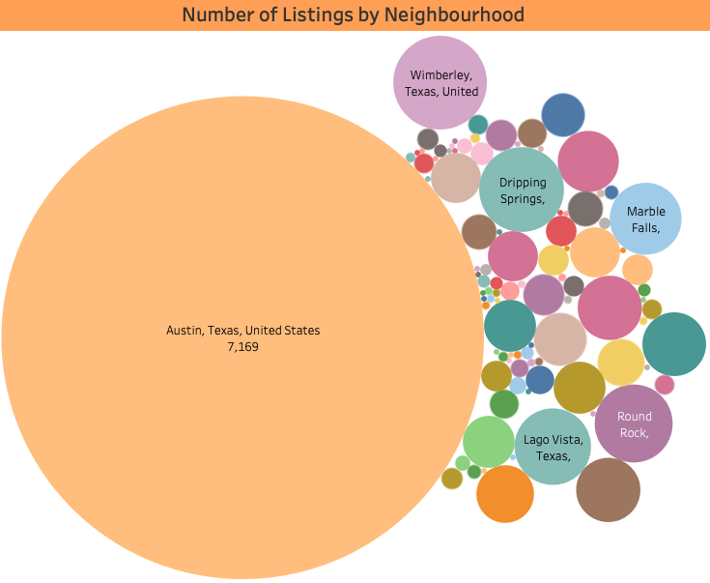
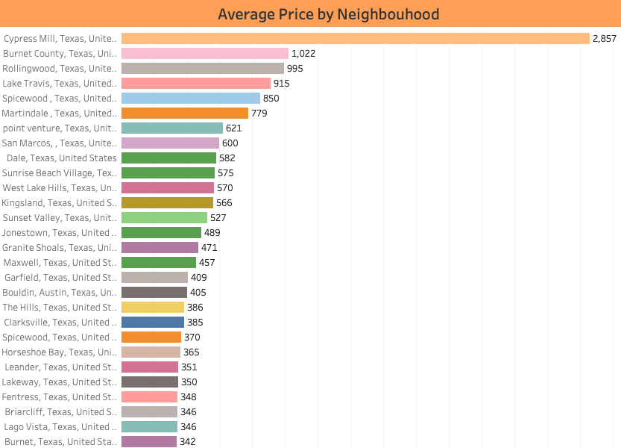
Neighborhoods and Average Price

Slide 8
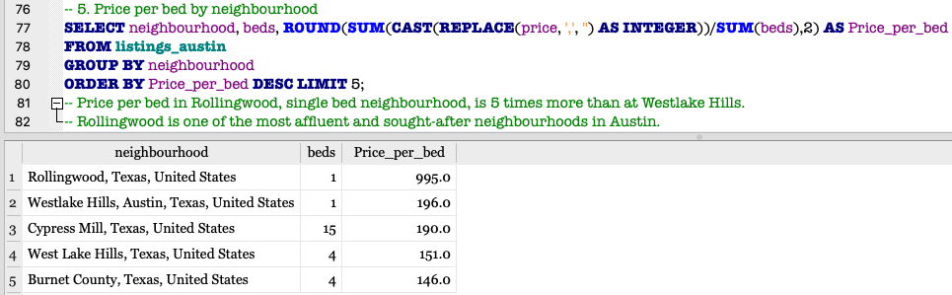
Price per Bed by Neighborhood
Price per bed is highest in Rollingwood, where it is approximately 80% more than at Westlake Hills.
In Austin, Rollingwood is one of the most sought-after and affluent neighborhoods. Hence high demand causes this high rates.
Cypress Mill, on other hand, contains 15 beds, resulting in a price per bed rate similar at Westlake Hills.

Slide 9
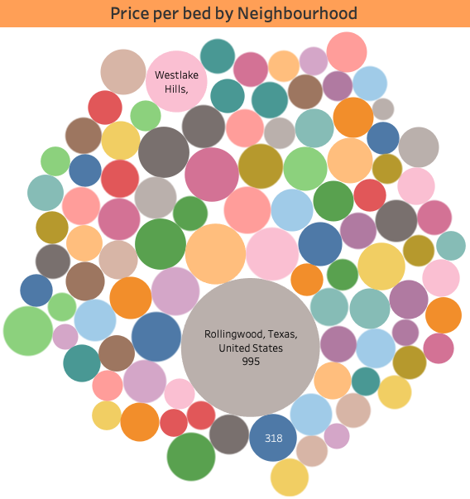
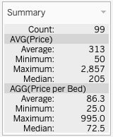
Price per Bed by Neighborhood

Slide 10
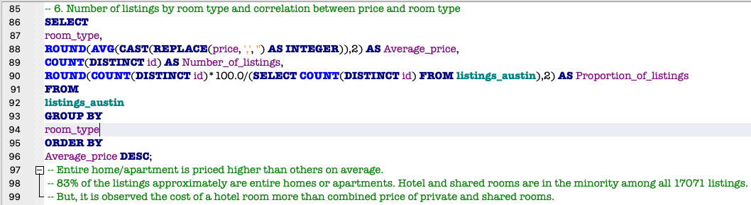
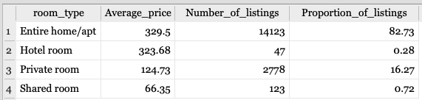
Room Type and Price Analysis
Entire homes or apartments are in high demand, accounting for 83% in Austin.
On average, price for a entire home is the highest.
A hotel room is priced more than the combined price of a private and shared room.
Private rooms make up 16% in Austin, with shared and hotel rooms in distant third and fourth.

Slide 11
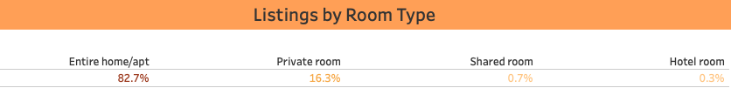
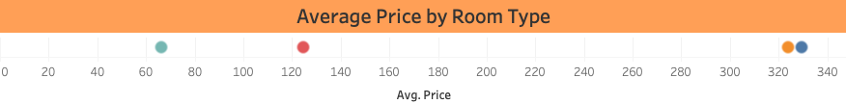
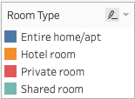
Room Type and Price Analysis

Slide 12
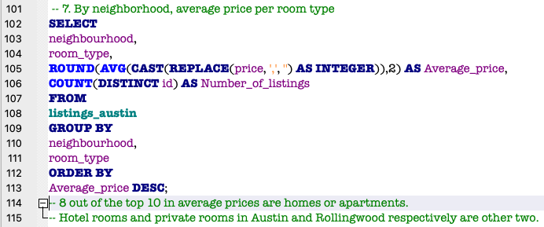
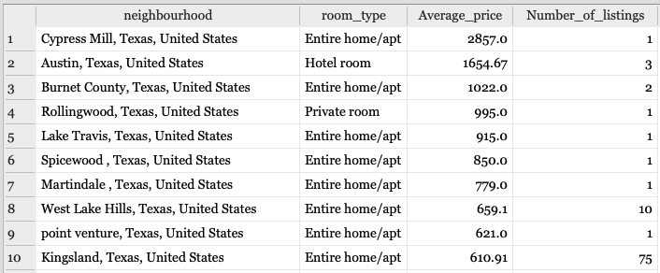
Price Analysis by each Neighbourhood and Room Type
Deeper look at correlation between price and room type by including each neighbourhood.
In average price, 8 out of 10 neighborhoods are homes or apartments.

Slide 13
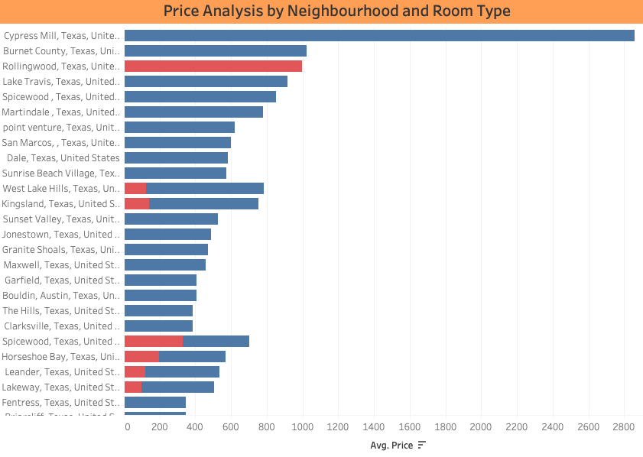
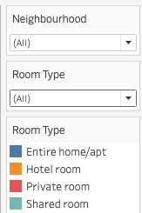
Price Analysis by each Neighbourhood and Room Type

Slide 14
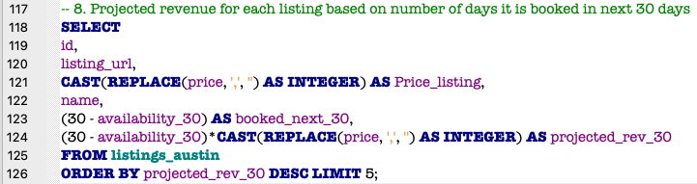
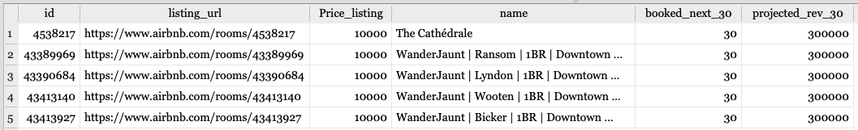
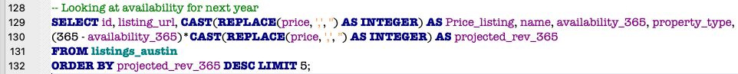
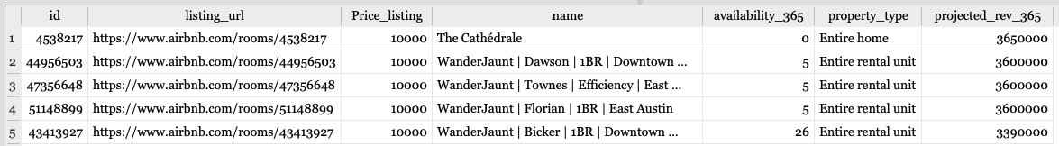
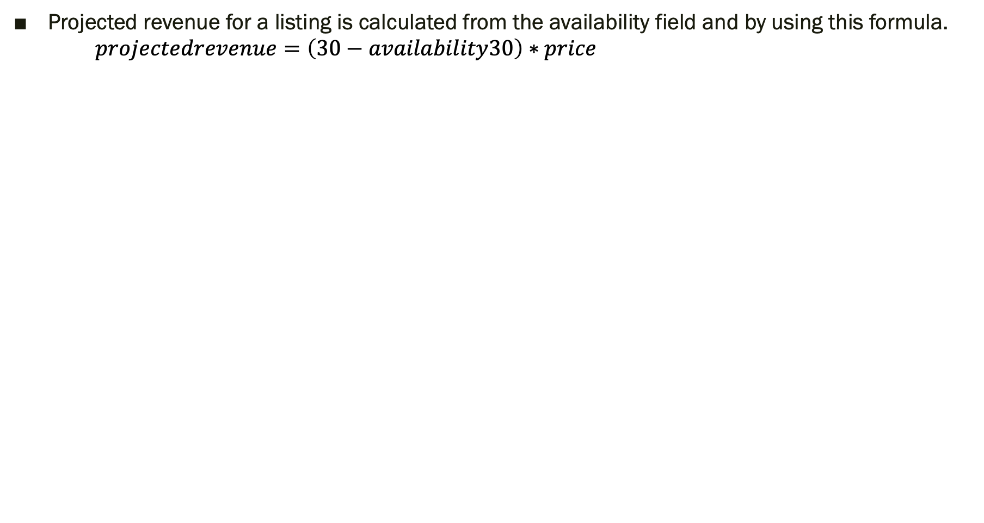
Top Revenue Earners in Next 30 days
Projected revenue for a listing is calculated from the availability field and by using this formula. $projectedrevenue=\left(30−availability30\right)∗price$
Maximum revenue a listing earns is 300,000.
Top 5 listings are either booked out or blocked by hosts in this period.
Availability for next year:
‘The Cathedrale’ property seems to be booked or blocked by hosts for the whole year.

Slide 15
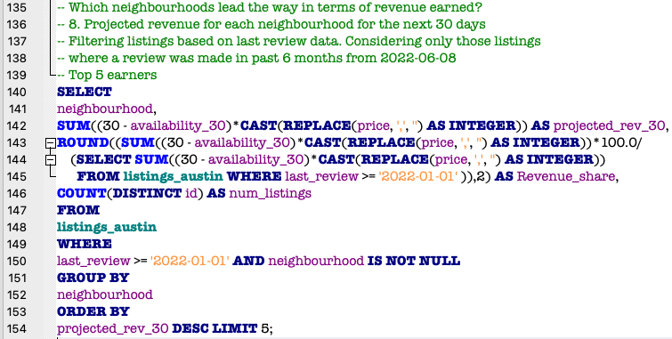
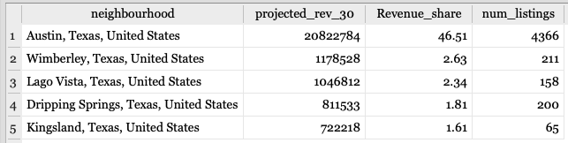
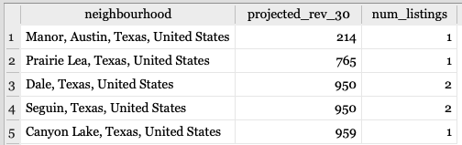
Revenue Potential by Neighborhood
Data is filtered using last review date to exclude ‘inactive listings’. Inactive listings are those who have received the last review beyond 6 months prior 2022-06-08.
Austin recoups the highest revenue in the 30-day period, with a 47% revenue share.
Four of the top 5 neighborhoods account for only 9% of the revenue share.
Single and double-listing neighborhoods give the least revenue potential.

Slide 16
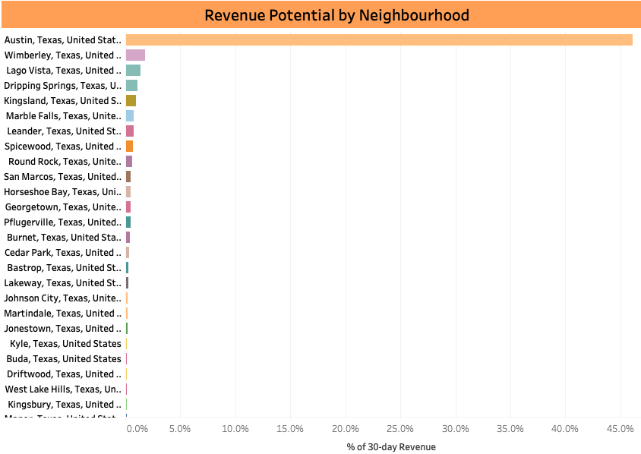
Revenue Potential by Neighborhood

Slide 17
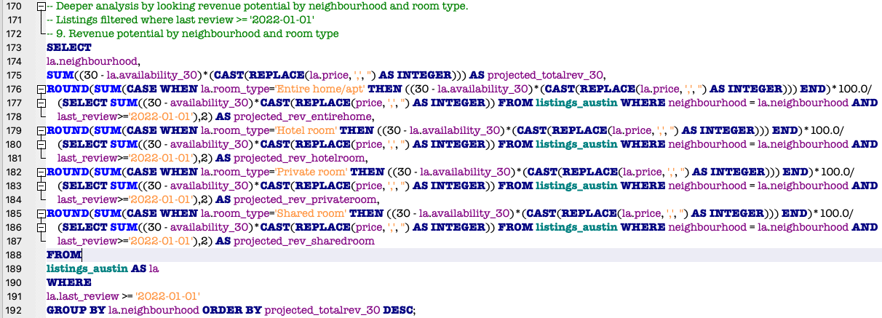
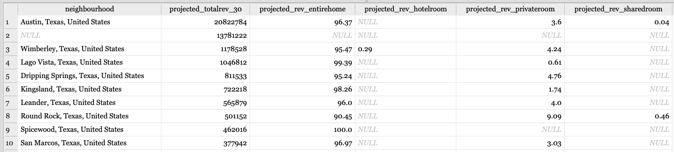
Revenue potential across Room Types
For majority of neighborhoods, entire homes earn more than 50% of the revenue.
Bluffton gets 1/3rd of its revenue from hotel rooms.
Paige is the only neighbourhood where private rooms account for 69% revenue share.

Slide 18
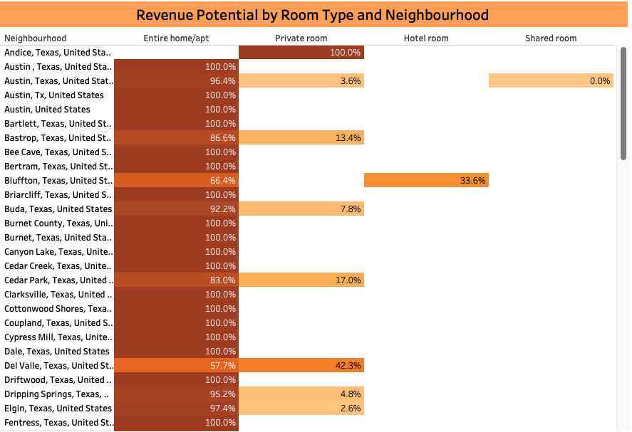
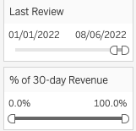
Revenue potential across Room Types

Slide 19
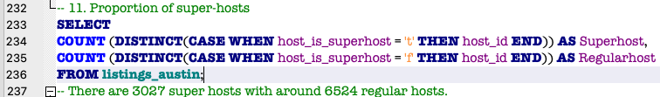
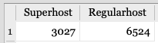
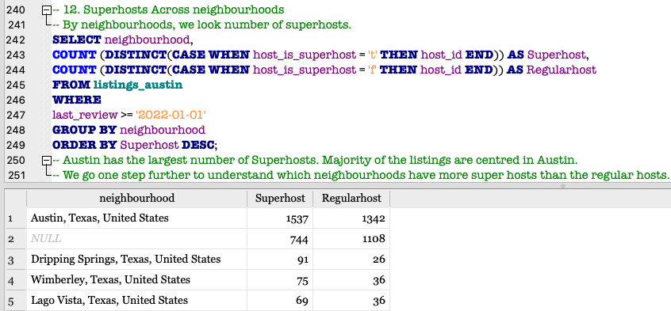
Superhosts by Neighbourhood
Who is a superhost? – A superhost is one who performs exceptionally in their hosting duties and give best customer service.
2/3rd of hosts are regular hosts, with little over 3000 being superhosts.
Below, inactive listings which received last review before 2022-01-01 are excluded.
Austin has the highest number of superhosts.
Out of 98 neighborhoods, 54 of them have more superhosts than regular hosts.

Slide 20
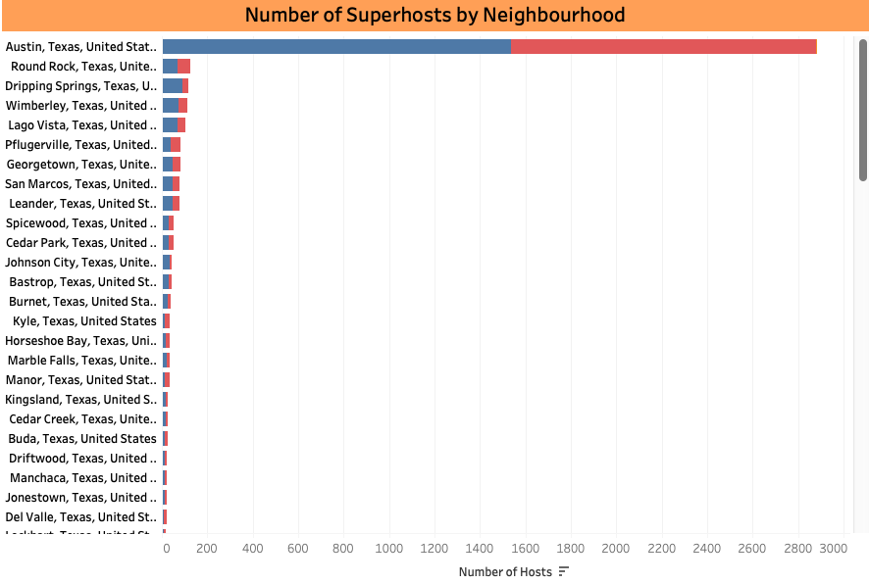
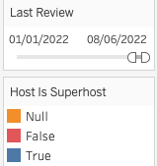
Superhosts by Neighbourhood

Slide 21
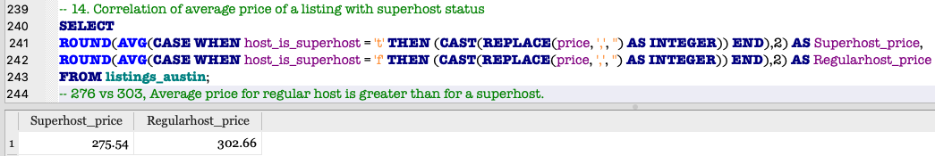
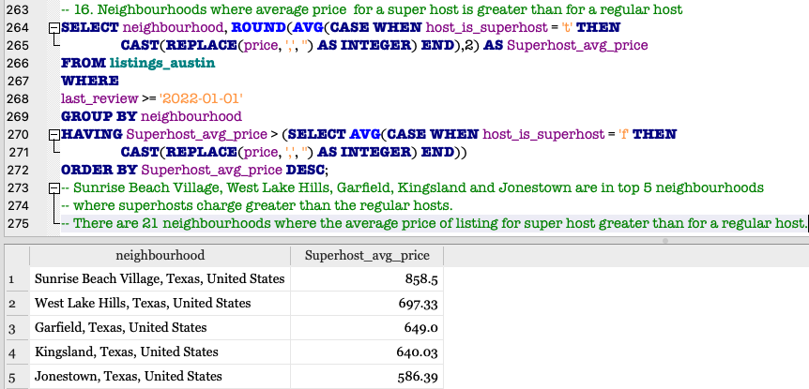
Correlation between price and superhost status
On average, price of a regular host listing is greater than that of a superhost listing.
There are 21 neighborhoods where superhosts charge more than the regular host.

Slide 22
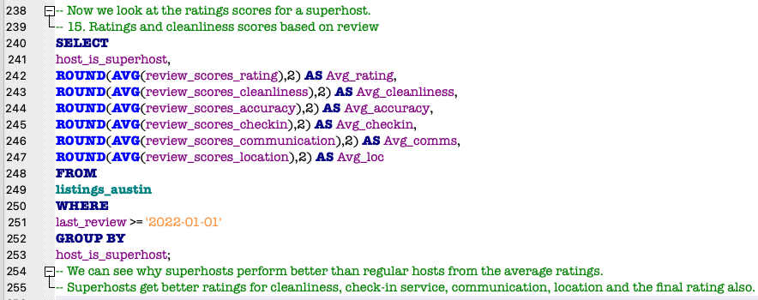
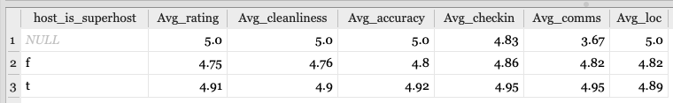
Ratings by a superhost status
Look at a tabular form of the average of all types ratings – cleanliness, location, communication etc. by a superhost status.
Broad view shows superhosts receive greater review scores than regular hosts.
A superhost receives highest average rating of 4.9.

Slide 23
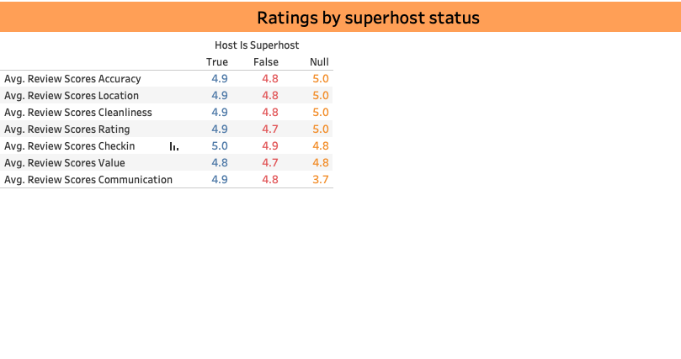
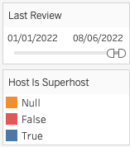
Ratings by a superhost status

Slide 24
Summary of the Findings
Hosts and listings: In Austin, we have 17071 listings and 9556 hosts. 80% of hosts have a single listing and there are hosts holding listings in the range from 1 to 400.
Neighbourhood: Austin accounts for approximately 42% listings against rest 97 neighborhoods. 4 of top 5 priced neighborhoods hold only 1 listing.
Price per bed: Rollingwood has the highest price per bed rate around $1000, 80% more than at Westlake hills. Cypress Mill having 15 beds offers rate similar to Westlake Hills.
Room type: Entire homes or apartments make up 83% of the properties, with their average price highest. Hotel rooms cost more than combined price of shared and private rooms. Private rooms make up 16% of the listing market.
Revenue potential: For the next 30 days, Austin projects close to 47% revenue share. Entire homes or apartments have more than 50-60% revenue share in majority of neighborhoods.
Superhosts: 32% of property owners are superhosts, with majority of them in Austin and 54 such neighborhoods having more superhosts than regular hosts.
Ratings: Superhosts appear to receive higher review scores on average for cleanliness, location, communication etc. than regular hosts.

Slide 25
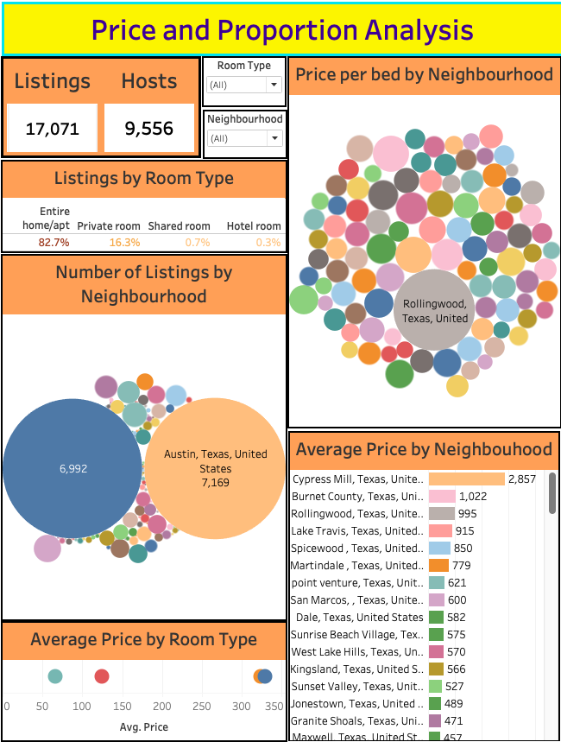
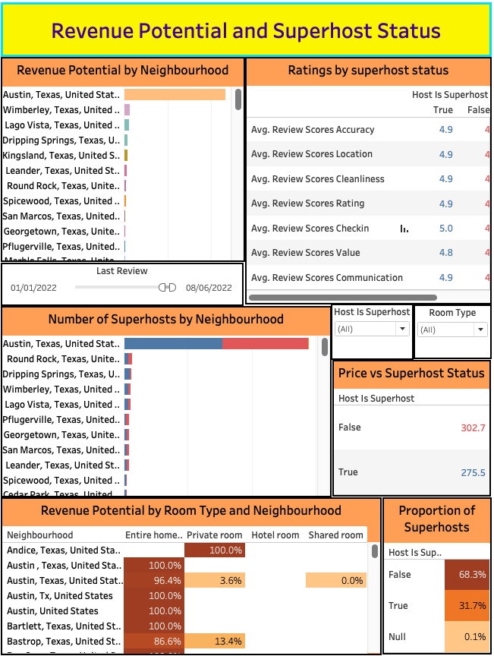
Dashboards in Tableau
Price and Proportion Analysis
Revenue Potential and Superhost Status

